Slide 1

Industry 4.0 Advancing IoT Through AI
Mouafek Ayadi
data scientist at oddo bhf
Microsoft Azure Data Scientist Associate
Google Africa Developer Mentor

Slide 2
Summary
1. What is Industry 4.0
2. What is Internet of Things (IOT)
3. What is Artificial Intelligence (AI)
4. Industry 4.0 and IoT digital revolution
5. Industrial AI’s Impact on Manufacturing
6. AI & IoT : A Powerful Combination
7. Conclusion and Perspectives

Slide 3
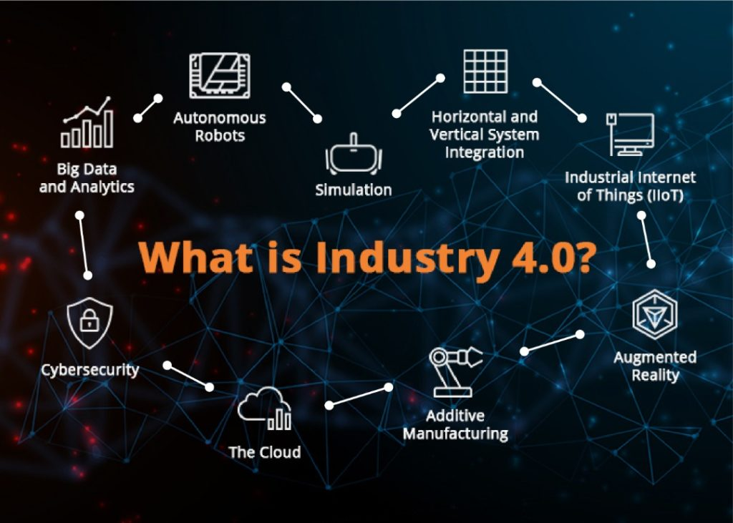

Slide 4
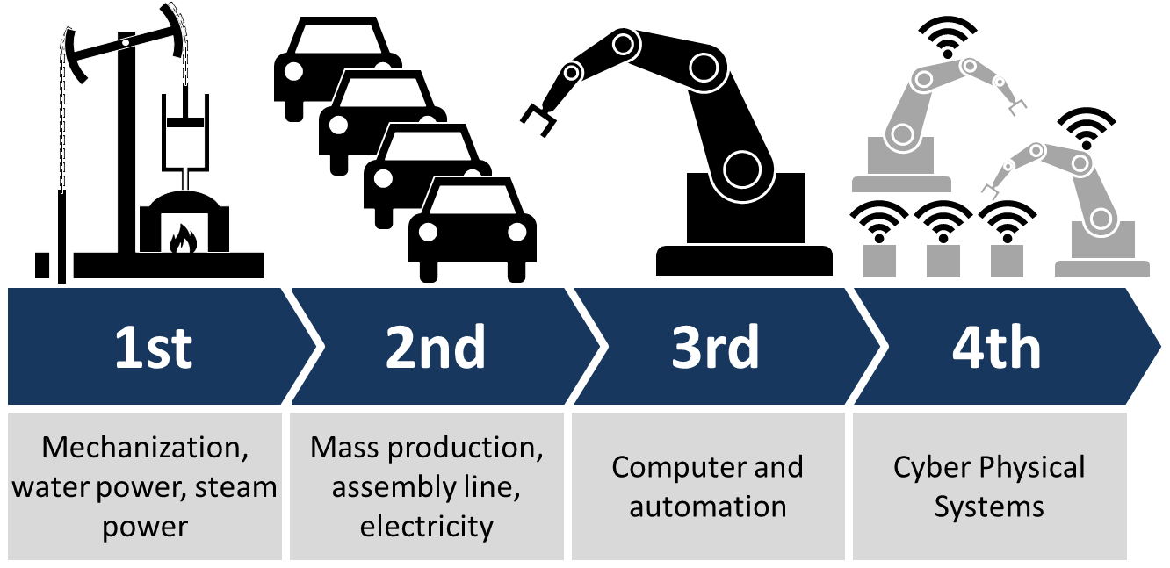
What is Industry 4.0 ?
Industry 4.0 is the digital transformation of manufacturing/production and related industries and value creation processes.
Industry 4.0 is used interchangeably with the fourth industrial revolution and represents a new stage in the organization and control of the industrial value chain.

Slide 5
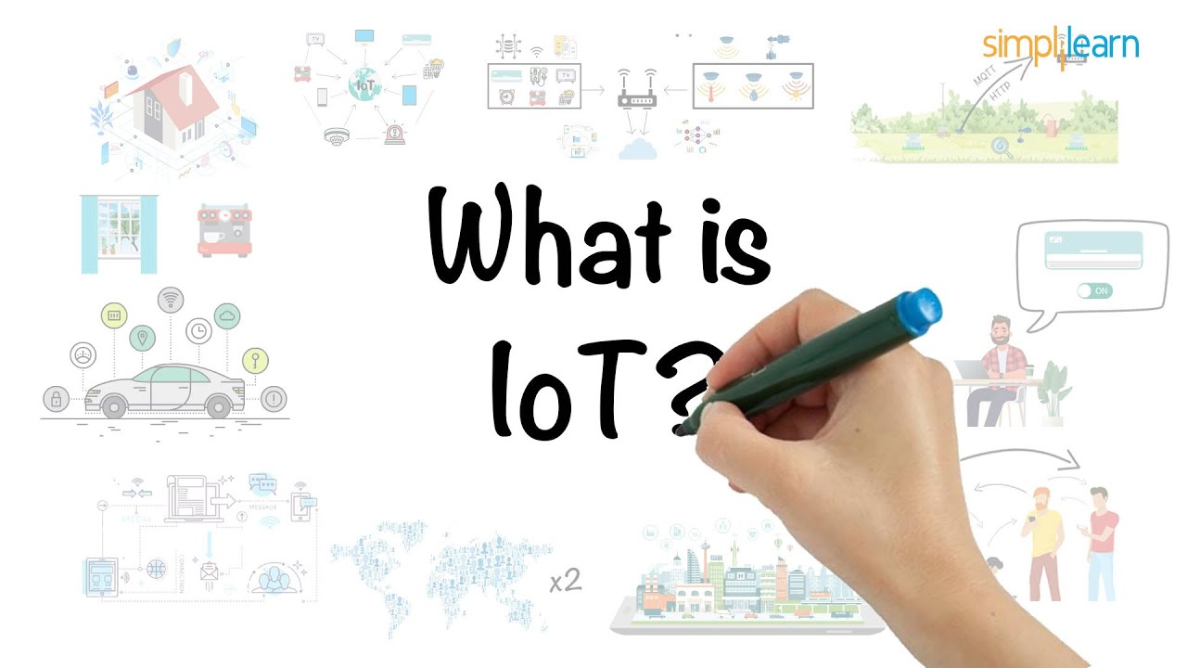

Slide 6
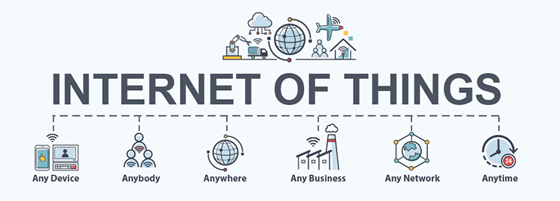
What is Internet of Things (IoT)
The internet of things, or IoT, is a system of interrelated computing devices, mechanical and digital machines, objects, animals or people that are provided with unique identifiers (UIDs) and the ability to transfer data over a network without requiring human-to-human or human-to-computer interaction.

Slide 8
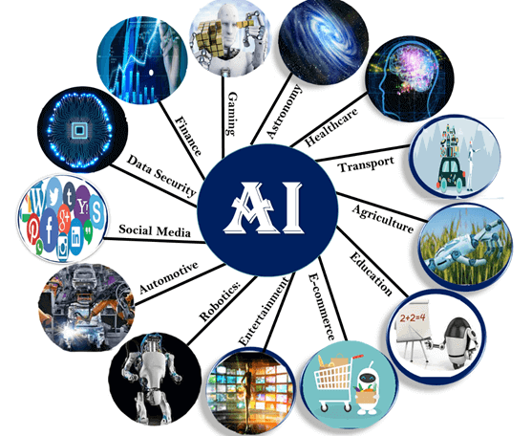
What is Artificial Intelligence (AI) ?
Artificial intelligence (A.I.) is generally defined as the property of machines that mimic human intelligence as characterized by behaviors such as cognitive ability, memory, learning, and decision making.

Slide 9
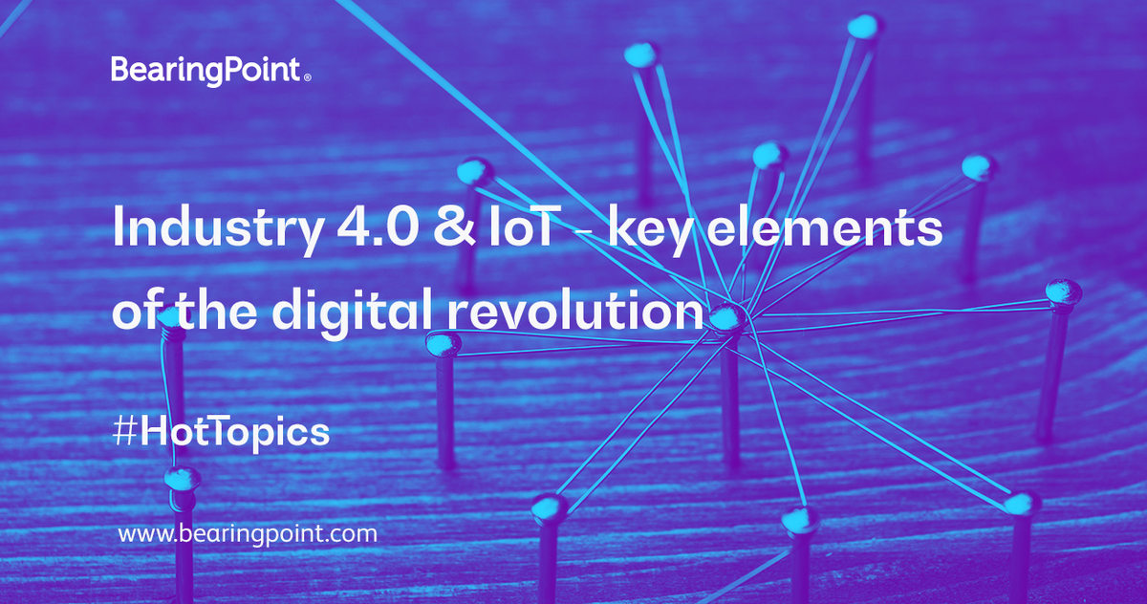
ITechno Cup 2020

Slide 10
Industry 4.0 and IoT Digital Revolution ?
Sensor Expertise and Machine Connection.
Sensing as a Service (what’s possible/agile IoT).
Edge Management Concept.
Secure connection and Device Management.
Data Lakes and Data Model.
Advanced Analytics.
Machine learning and prediction.
Business Model creation and Business case.

Slide 11
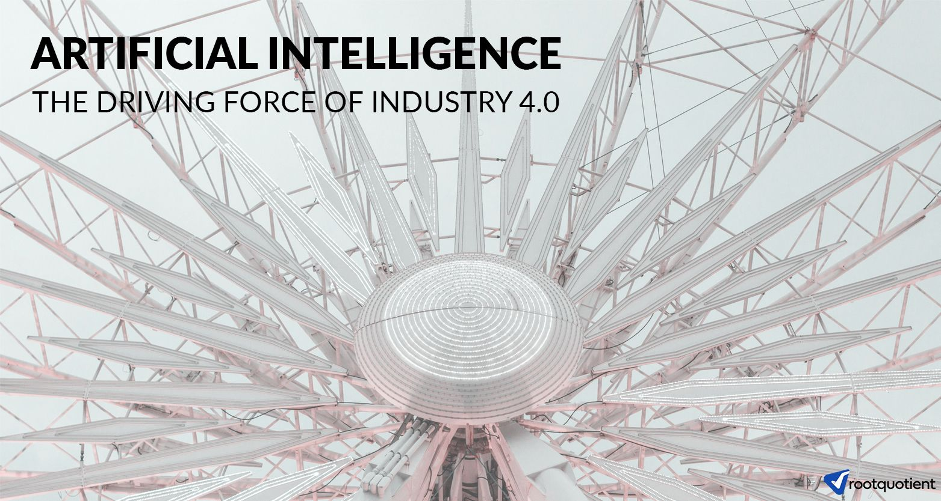
ITechno Cup 2020

Slide 12
Artificial Intelligence The Driving Force of Industry 4.0
Predictive maintenance.
Generative design.
Price forecasting of raw material.
Robotics.
Edge analytics.
Quality assurance.
Process optimization.

Slide 13
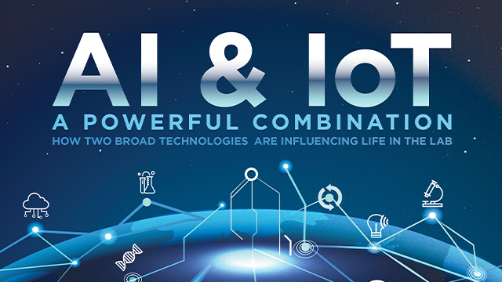
ITechno Cup 2020

Slide 14
AI & IoT A Powerful Combination
The convergence of AI (Artificial Intelligence) and IoT can redefine the way industries, business, and economies functions.
AI enabled IoT creates intelligent machines that simulate smart behavior and supports in decision making with little or no human interference.
Combining these two streams benefits the common person and specialists alike.
While IoT deals with devices interacting using the internet, AI makes the devices learn from their data and experience.

Slide 15
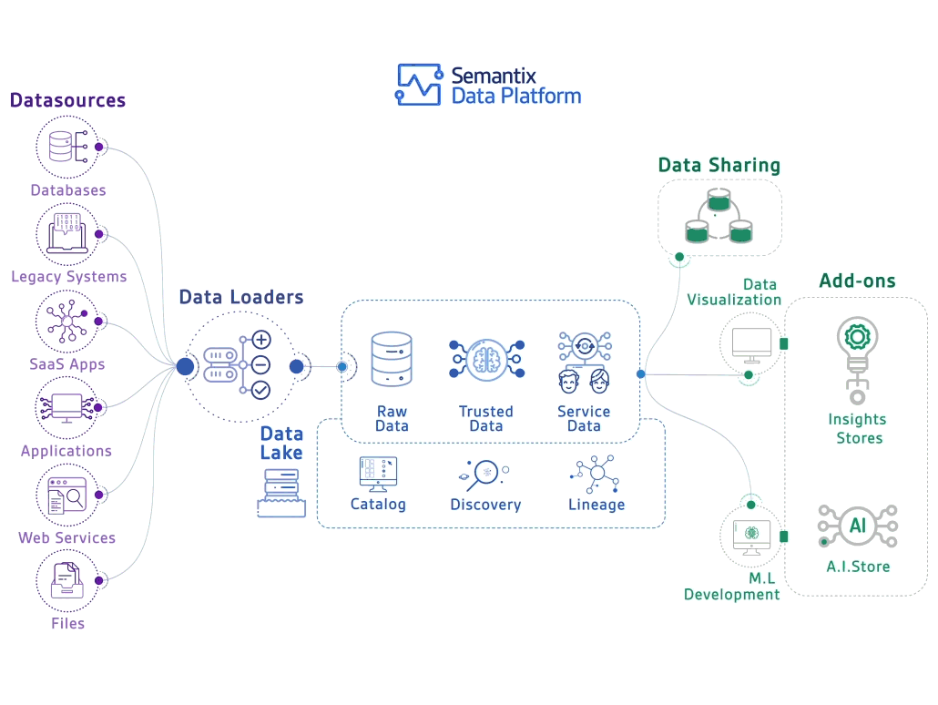
AI & IoT A Powerful Combination

Slide 16
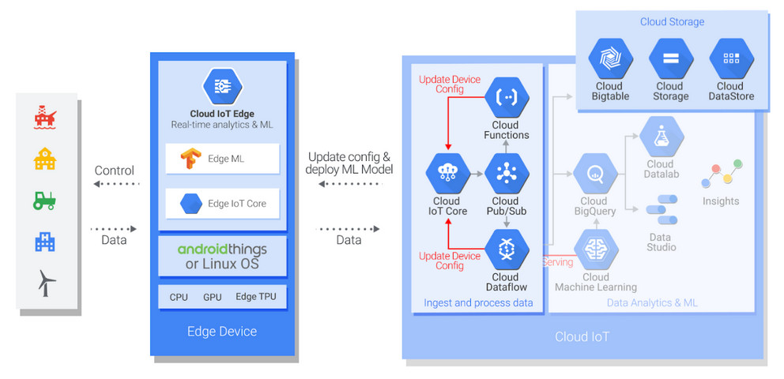
AI & IoT A Powerful Combination
Google Cloud Services for IOT and AI are all located in one platform called 𝐆𝐨𝐨𝐠𝐥𝐞 𝐈𝐨𝐓 𝐏𝐥𝐚𝐭𝐟𝐨𝐫𝐦, where 𝐄𝐝𝐠𝐞 𝐃𝐞𝐯𝐢𝐜𝐞𝐬 send data to 𝐂𝐥𝐨𝐮𝐝 𝐈𝐎𝐓 𝐄𝐝𝐠𝐞.
𝐂𝐥𝐨𝐮𝐝 𝐈𝐎𝐓 𝐂𝐨𝐫𝐞 connect, manage, and ingest data through 𝐆𝐨𝐨𝐠𝐥𝐞 𝐏𝐮𝐛/𝐒𝐮𝐛, then the data is stored in 𝐂𝐥𝐨𝐮𝐝 𝐒𝐭𝐨𝐫𝐚𝐠𝐞.
Google offers 𝐂𝐥𝐨𝐮𝐝 𝐌𝐚𝐜𝐡𝐢𝐧𝐞 𝐋𝐞𝐚𝐫𝐧𝐢𝐧𝐠 to implement AI solution and other services like Big Data Analysis like 𝐁𝐢𝐠𝐐𝐮𝐞𝐫𝐲,

Slide 17
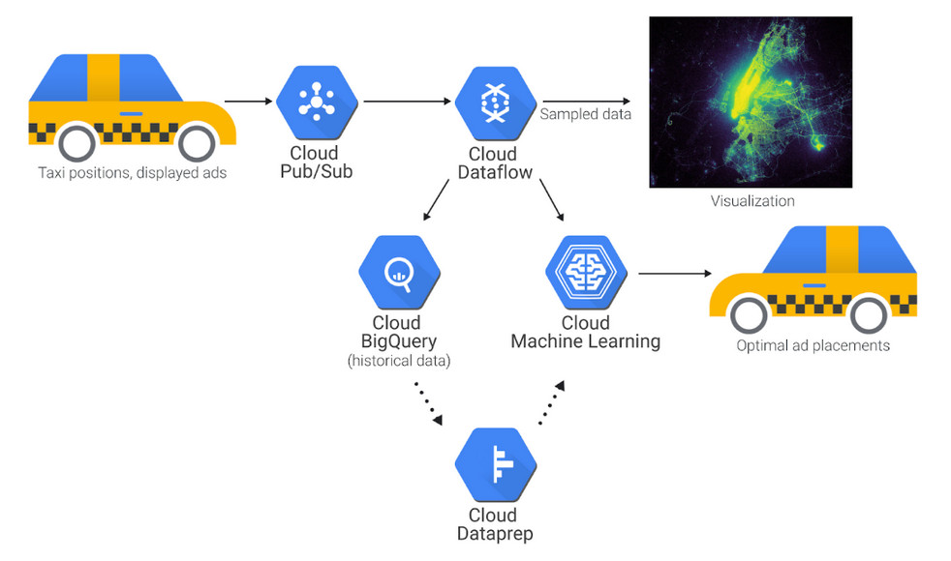
AI & IoT A Powerful Combination
The data pipeline collects data from New York City taxis using Cloud Pub/Sub and a Dataflow pipeline. The data is visualized as an overlay to a map of New York City, with green dots representing taxis.BigQuery is used to gather and explore the data set.
With Cloud Dataprep resides you can create recipes to transform and clean the data in preparation for Cloud ML Engine. The recipes will work on historical data and all data streaming into the pipeline

Slide 18
Thank You
Q & A

